Slide 1
Chrome Browser A gdpr case study

Slide 2
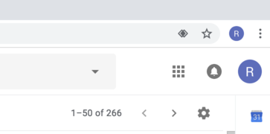
“am I logged into the system or into the browser?”
This change apparently “solves” the hypothetical issue of user confusion: “am I logged into the system or into the browser?” (and at the same time is creating others).
SUDDEN CHANGE:
Things work very different than, say, in Chrome 68 (released 2018-07-24).

Slide 3
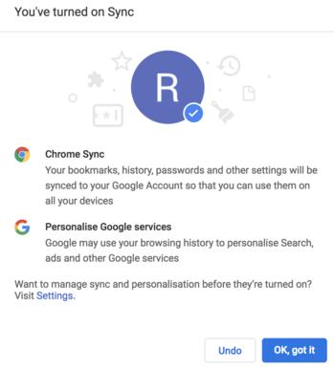
Mistaken sync

Slide 4
DPIA
Article 35 of GDPR requires making an assessment taking into account the “fundamental rights and freedoms” of an individual. Now, I am not sure Chrome has a DPIA at all. Projects made prior to GDPR do not need to have one.
However, data protection impact assessment (DPIA) must be updated when significant changes in the system are introduced. In this case, pre-GDPR projects effectively need to have one made (if not having one).

Slide 5
Data protection by design
The case of Chrome login discussed here might be one of the best examples for a case study. It is high impact (lots of users), concerns expectations and defaults, and is about changing how things work. Clarity of user interface, what the user expects, and what actually happens - are the key elements.

